Slide 1
Lecture 02 - Image Filtering
Prof. André Gustavo Hochuli
gustavo.hochuli@pucpr.br
aghochuli@ppgia.pucpr.br
Notes:
Prof. André Hochuli

Slide 2
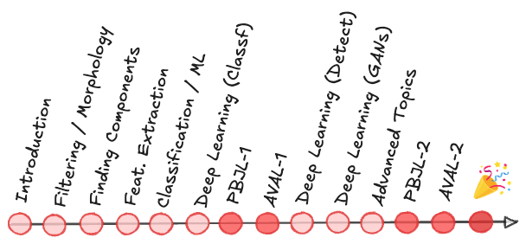
Topics
Discussion of Practice 01
Image Filtering
Convolution
Smothing, Shapening and Edge Filters
Practice
Computer Vision - Prof. André Hochuli
Lecture 02
Notes:
Prof. André Hochuli

Slide 3
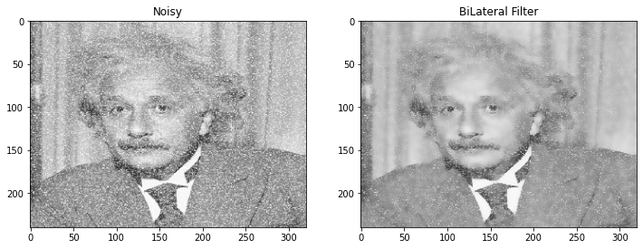
Image Filtering
_{Image Enhacement}
_{Noise Reduction}
Smothing, Sharpening and Edge Filter
_{Convolutional-Based Operations}
Computer Vision - Prof. André Hochuli
Lecture 02
Notes:
Prof. André Hochuli

Slide 4
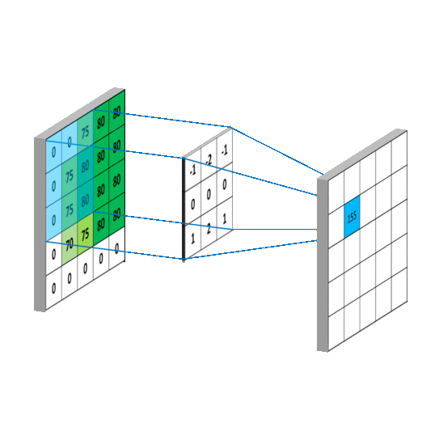
Convolution
Slides a kernel (a.k.a convolution filter) in the entire image
Transforming the pixel in the center of the kernel by the weights of its neighbors.
Computer Vision - Prof. André Hochuli
Lecture 02
Notes:
Prof. André Hochuli

Slide 5
Convolution
Computer Vision - Prof. André Hochuli
Lecture 02
Notes:
Prof. André Hochuli

Slide 6
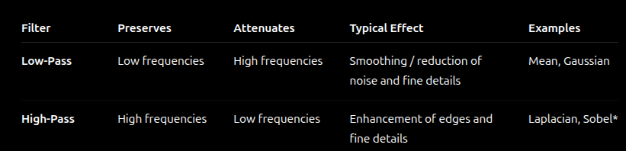
Spatial Frequency
Spatial frequency: rate of intensity variation across space
Low Frequency → Slow Intensity Variations
Smooth or homogeneous regions : [100, 102, 98, 103, 99]
High Frequency → Rapid Intensity Variations
Edges, fine details, textures, and often noise: [100, 145, 73, 132, 88]
Computer Vision - Prof. André Hochuli
Lecture 02
Notes:
Prof. André Hochuli

Slide 7
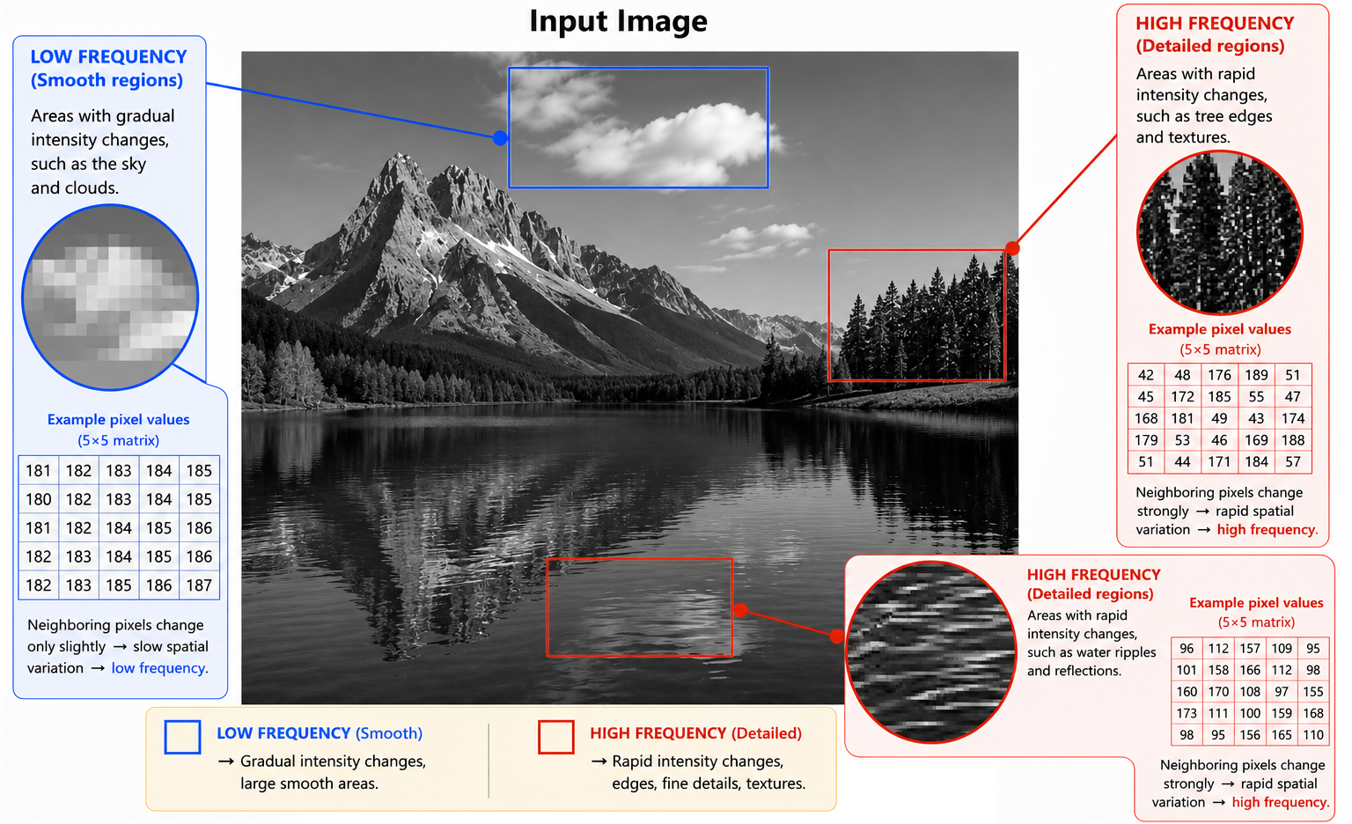
Spatial Frequency
Computer Vision - Prof. André Hochuli
Lecture 02
Notes:
Prof. André Hochuli

Slide 8
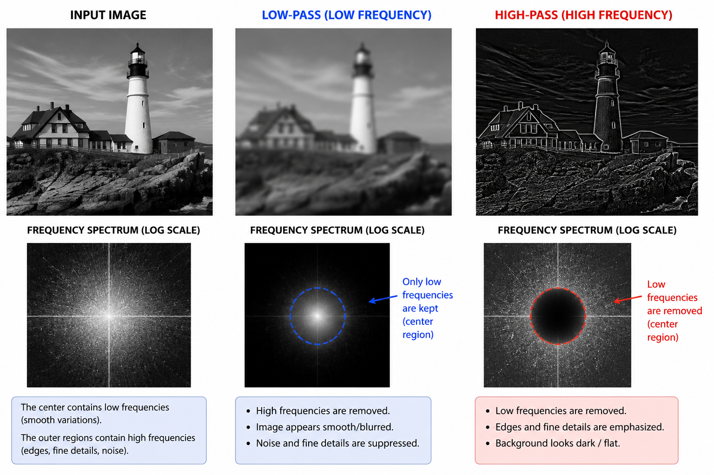
Low- and High-Pass Filters
Computer Vision - Prof. André Hochuli
Lecture 02
Notes:
Prof. André Hochuli

Slide 9
Smothing
Notes:
Prof. André Hochuli

Slide 10
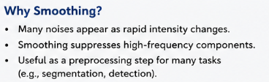

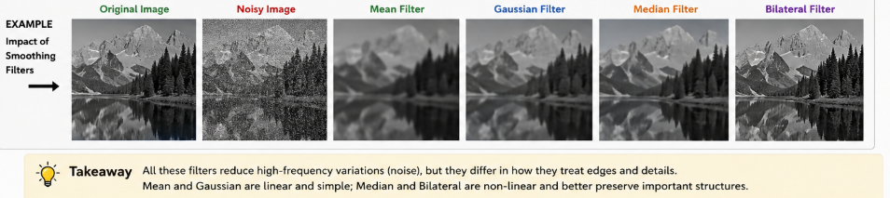
Smothing Filters
Goal: Reduce rapid intensity variations and attenuate image noise
Main Effect: Produce smoother images by suppressing high-frequency components
Computer Vision - Prof. André Hochuli
Lecture 02
Notes:
Prof. André Hochuli

Slide 11
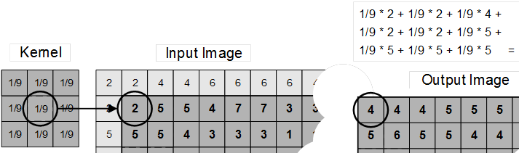
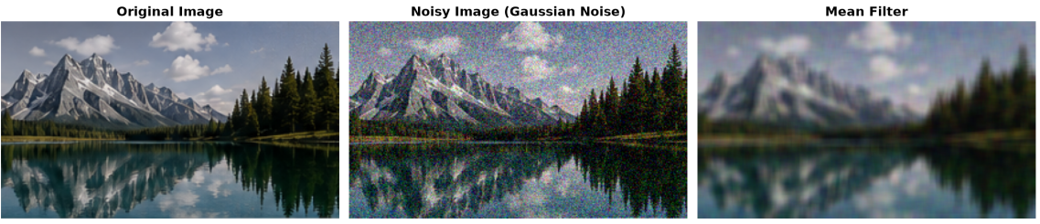
Mean Filter (Low-Pass)
Replaces the center pixel with the mean of its neighborhood
Spreads (Average) the outlier value to its neighbors
_{Details are smoothed}
Computer Vision - Prof. André Hochuli
Lecture 02
Notes:
Prof. André Hochuli

Slide 12
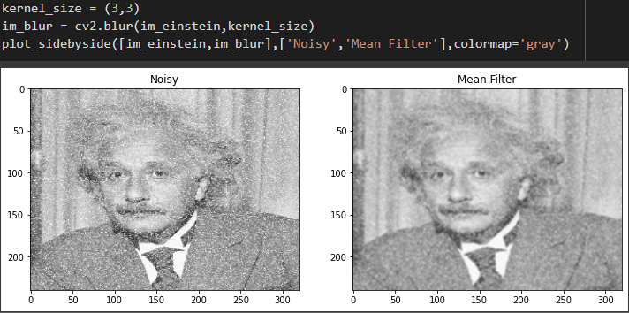
Mean Filter (Low-Pass)
Replaces the center pixel with the mean of its neighborhood
Spreads (Average) the outlier value to its neighbors
_{Details are smoothed}
Computer Vision - Prof. André Hochuli
Lecture 02
Notes:
Prof. André Hochuli

Slide 13
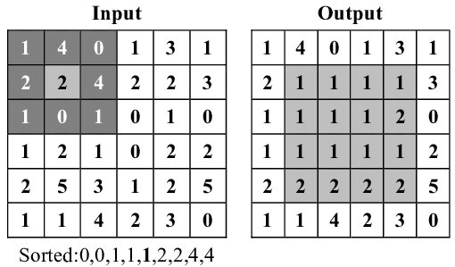
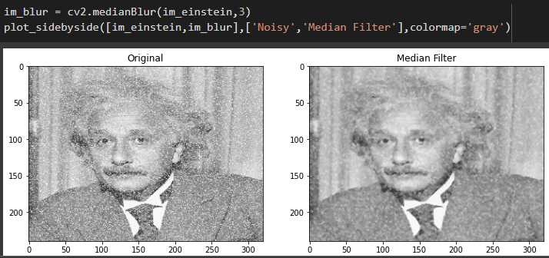
Median Filter
Replaces the center pixel with by a median of its neighborhood
Preserves more details when compared to the mean filter
Computer Vision - Prof. André Hochuli
Lecture 02
Notes:
Prof. André Hochuli

Slide 14
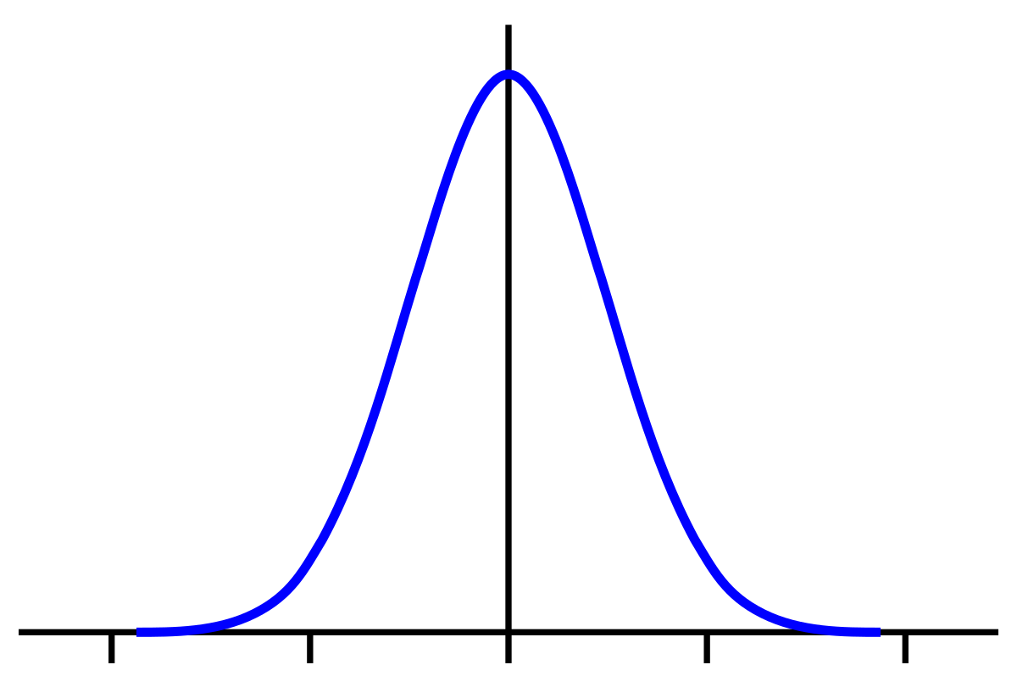
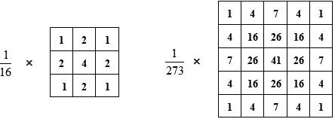
Gaussian Filter (Low-Pass)
Gaussian distribution of pixels
The kernel is composed of probabilities
_{Weighted Mean}
The standard deviation determines the blur degree
Computer Vision - Prof. André Hochuli
Lecture 02
Notes:
Prof. André Hochuli

Slide 15
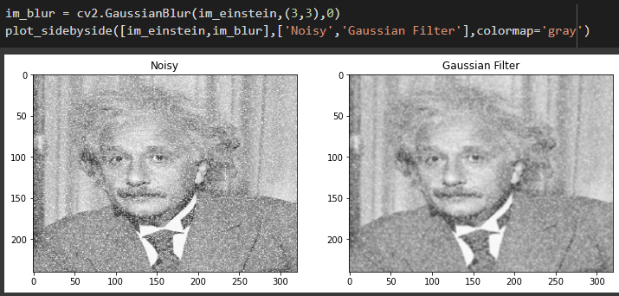
Gaussian Filter
Gaussian distribution of pixels
The kernel is composed of probabilities
_{Weighted Mean}
The standard deviation determines the blur degree
Computer Vision - Prof. André Hochuli
Lecture 02
Notes:
Prof. André Hochuli

Slide 16
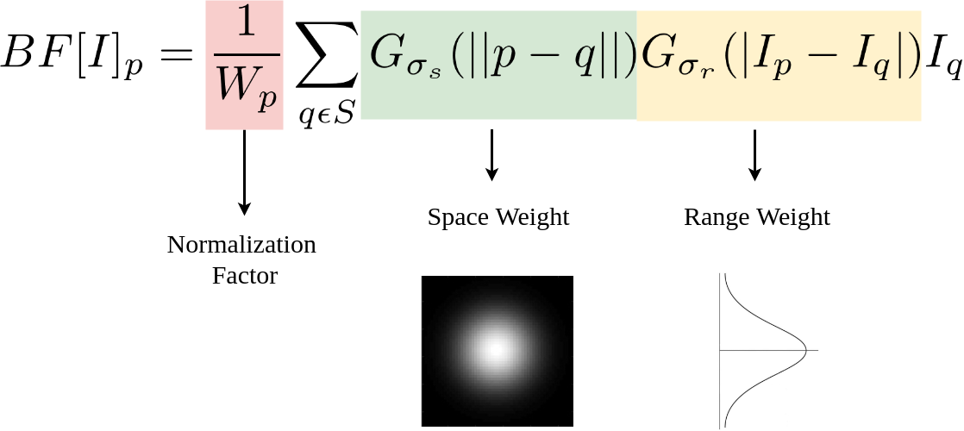
Bilateral Filter
Gaussian Distribution based (spacial and pixel intensity)
Add Normalization Factors and Range Weight
_{Preserve details}
Computer Vision - Prof. André Hochuli
Lecture 02
Notes:
Prof. André Hochuli

Slide 17
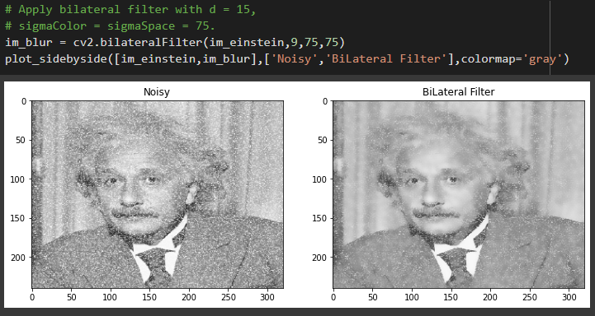
Bilateral Filter
Gaussian Distribution based (spacial and pixel intensity)
Add Normalization Factors and Range Weight
_{Preserve details}
Computer Vision - Prof. André Hochuli
Lecture 02
Notes:
Prof. André Hochuli

Slide 18
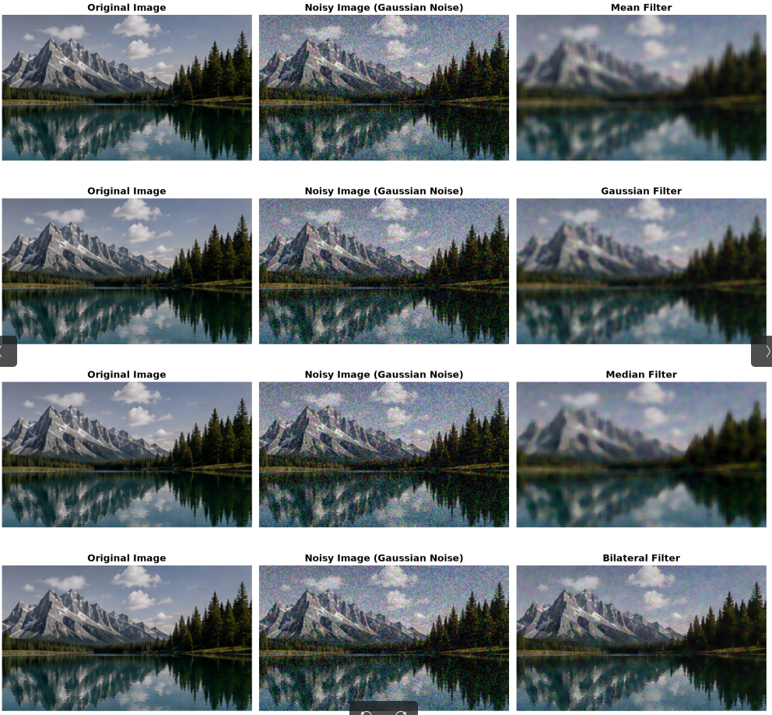
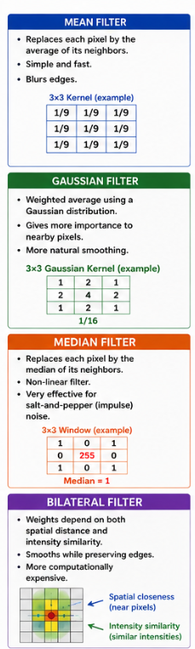
Comparison
Computer Vision - Prof. André Hochuli
Lecture 02
Notes:
Prof. André Hochuli

Slide 19
Practice
_{Link: Practice 02}
Computer Vision - Prof. André Hochuli
Lecture 02
Notes:
Prof. André Hochuli

Slide 20
Sharpening and Edge Filters
Notes:
Prof. André Hochuli

Slide 21
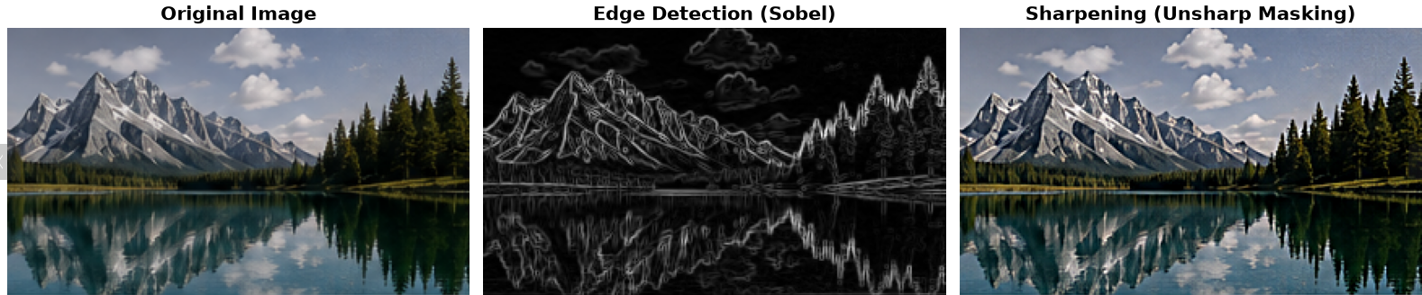
Sharpening and Edge Filters
Smoothing suppresses high-frequency information; sharpening and edge filters emphasize it.
High Frequencies are associated with:
Edges and object boundaries, Fine details, Textures, Noise
Computer Vision - Prof. André Hochuli
Lecture 02
Notes:
Prof. André Hochuli

Slide 22
Sharpening and Edge Filters
Smoothing suppresses high-frequency information; sharpening and edge filters emphasize it.
High Frequencies are associated with:
Edges and object boundaries, Fine details, Textures, Noise
Computer Vision - Prof. André Hochuli
Lecture 02
Notes:
Prof. André Hochuli

Slide 23
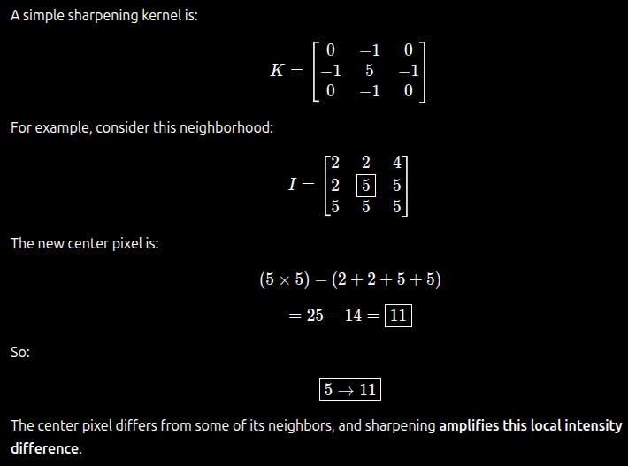
Sharpening
Computer Vision - Prof. André Hochuli
Lecture 02
Notes:
Prof. André Hochuli

Slide 24
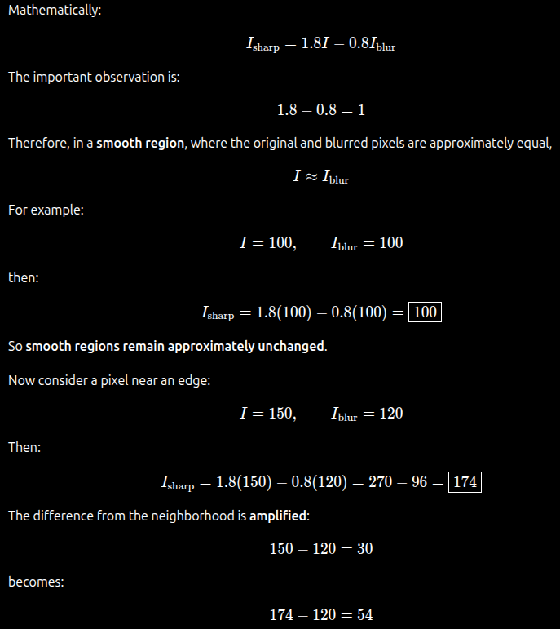
Sharpening
_{Unsharp Mask (blur + sharp)}
Computer Vision - Prof. André Hochuli
Lecture 02
Notes:
Prof. André Hochuli

Slide 25
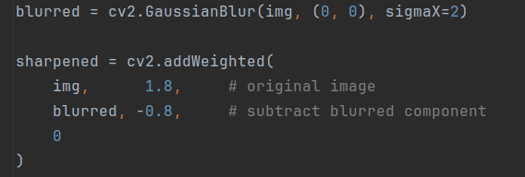
Sharpening
_{Unsharp Mask (blur + sharp)}
Computer Vision - Prof. André Hochuli
Lecture 02
Notes:
Prof. André Hochuli

Slide 26
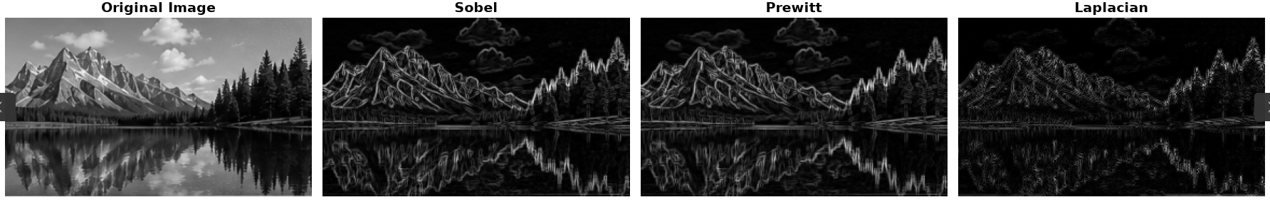
Edge Detection
Identifies locations of significant intensity changes
Produces a representation emphasizing object boundaries
Computer Vision - Prof. André Hochuli
Lecture 02
Notes:
Prof. André Hochuli

Slide 27
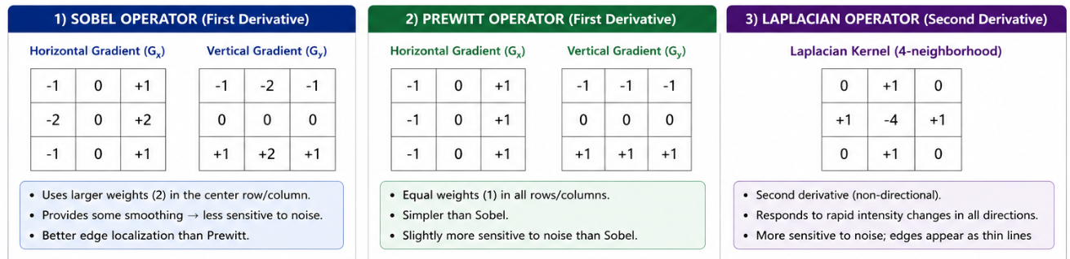
Edge Detection
Computer Vision - Prof. André Hochuli
Lecture 02
Notes:
Prof. André Hochuli

Slide 28
Practice
_{Link: Practice 02}
Computer Vision - Prof. André Hochuli
Lecture 02
Notes:
Prof. André Hochuli

